Slide 1
Universal Credit:
Enabling Work
Surrey and Sussex UC Awareness 2019

Slide 2
Universal Credit Full Service
Universal Credit Full Service replaces the following benefits:
Job Seekers Allowance (Income Based)
Child Tax Credit
Working Tax Credit
Employment Support Allowance (Income Based)
Housing Benefit
Income Support
Notes:
Universal Credit is the biggest change in the welfare system for 60 years. It reflects the world of work – it is paid monthly, and we ask people to sign a commitment, like a contract.
By the time it is fully implemented, around 8 million people will be receiving UC, many of whom will be in work

Slide 3
Universal Credit
Universal Credit is ‘opening up work’ and allowing access to a wider range of jobs by:
helping make sure people are always better off in work than on benefits
allowing part-time and short-term work to act as a stepping stone into work
enabling people to work more than 16 hours a week and still claim Universal Credit
paying towards registered childcare costs, giving people more flexible working hours
Notes:
helping make sure you’re always better off in work than on benefits
UC better incentivises work by making sure that claimants are always better off financially in work, regardless of how much they’re earning.
allowing part-time and short-term work to act as a stepping stone into work
Because UC used Real Time Information from HMRC to calculate entitlement, a claimant can start on just a handful of hours per week to see how they manage, then increase gradually as their circumstances allow, always having the UC there as a safety net.
enabling you to work more than 16 hours a week and still claim Universal Credit
Because of the above and the taper system covered shortly, and the fact that the ‘16 hour rule’ no longer exists, there is no longer the fear that by doing a few hours of work someone’s claim to benefit will just stop. No ‘cliff edge’, just a gentle tapering of the UC award.
paying towards your childcare costs, giving you more flexible working hours
Can claim up to 85% towards childcare costs under UC, where under Tax Credits could only claim up to 70%. Also, because of the abolishment of the ‘16 hour rule’ there is no minimum number of hours to qualify a claimant for support with childcare costs, so they can access it sooner.

Slide 4
Universal Credit
Universal Credit has been designed to make the transition from benefits to work easier, and provide better financial support to those claiming it.
Whether on a low income or out of work, Universal Credit encourages people to find a job or increase the hours they work, and they will get help from a work coach to support them every step of the way.
Taking a job will always be worthwhile, regardless of whether it’s just a few hours per week or temporary.
When someone starts work or increases their hours, Universal Credit will top up their earnings each month. It will gradually reduce as their earnings increase. And if the job ends, it’s easy to start their Universal Credit payments again.
Notes:
What does your customer base look like: talk about what your area looks like, they type of customers, what they are looking for etc.
Large percentage of customers claiming have a health condition or disability, could need extra support into work, may take longer to find work etc. may need adaptions to work space, hours etc
Lone parents, flexible working, hours to fit with school times, holidays

Slide 5
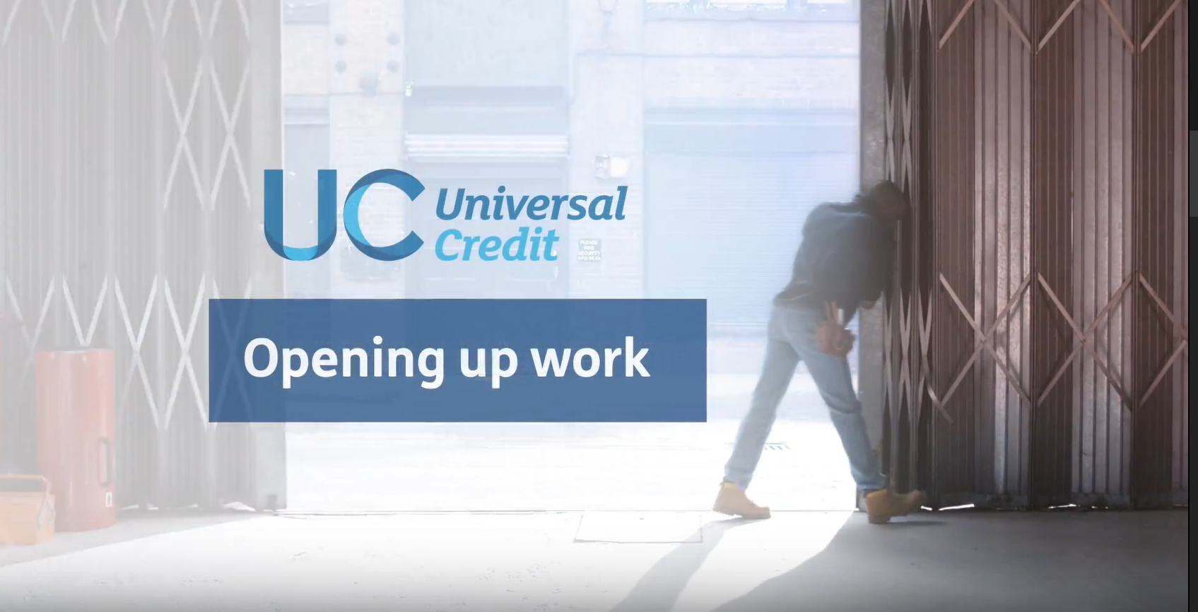
How Universal Credit Works for Employers
Notes:
You Tube video showing how UC works for employers – 2 minutes long

Slide 6
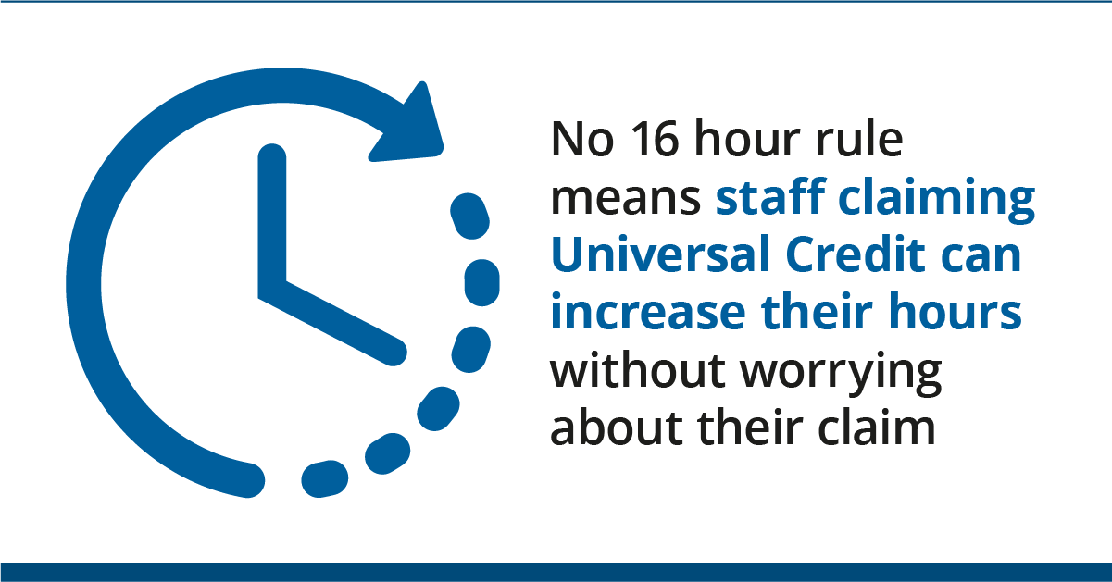
Flexibility
Universal Credit helps you manage natural peaks and troughs within your business by allowing your workforce to be able to :
Be flexible about their hours, able to take on overtime or extra shifts – UC will adjust automatically helping you avoid recruiting and training new staff
Increase to full-time hours, for example over the busy Christmas period
Notes:
Universal Credit is designed to ensure that people are better off in work. By making it easier for people to vary the number of hours each week Universal Credit can help provide your business with a more flexible workforce:
•Universal Credit claimants will be more open to short-term work or flexible hours because they won’t have to worry about what it means for their claim.
•Universal Credit removes the old ‘16 hour’ rule as payments are based on earnings rather than the number of hours worked.
Universal Credit helps you manage natural peaks and troughs within your business. Universal Credit claimants on your workforce will be able to:
•be flexible about their hours – employees won’t have to worry about their claim, any change in earnings will mean their Universal Credit adjusts automatically. They can accept offers of overtime or more hours, helping you to avoid the overheads associated with recruiting and training new staff.
•increase to full-time hours – employees will be able to do this, for example over the busy Christmas period. They will be automatically notified if their higher earnings mean their Universal Credit stops, but if their hours reduce within 6 months it’s easy for them to get Universal Credit again.
•accept any bonuses offered – although a bonus could temporarily reduce or stop an employee’s Universal Credit payment, it’s easy for them to get Universal Credit again.

Slide 7


Reporting Earnings
Because Universal Credit uses the existing PAYE real-time information that you already send to HMRC, Universal Credit payments adjust automatically without claimants needing to do anything. And it won’t add to your business costs.
The PAYE information you send to HMRC is forwarded to DWP to be taken into account when calculating a claimant’s next Universal Credit payment. This means it is vital the information submitted is accurate and on time.

Slide 8
Recruitment
Universal Credit helps you in your recruitment process because it:
provides better prepared applicants – jobseekers will receive job preparation, digital and budgeting skills and will be financially more ready for the world of work, coming from a monthly payment system
Work coaches in Jobcentres will continue to encourage people to increase their hours or responsibilities
provides a wider pool of applicants – Universal Credit claimants will be more open to short-term, part-time or irregular work
Notes:
Find a Job, provides facility for employers to post vacancies for free, job seekers can view and apply for vacancies, since May 2018 over 46.8 million adverts have been viewed and 14.6 applications made via this site.
YouTube video -

Slide 9
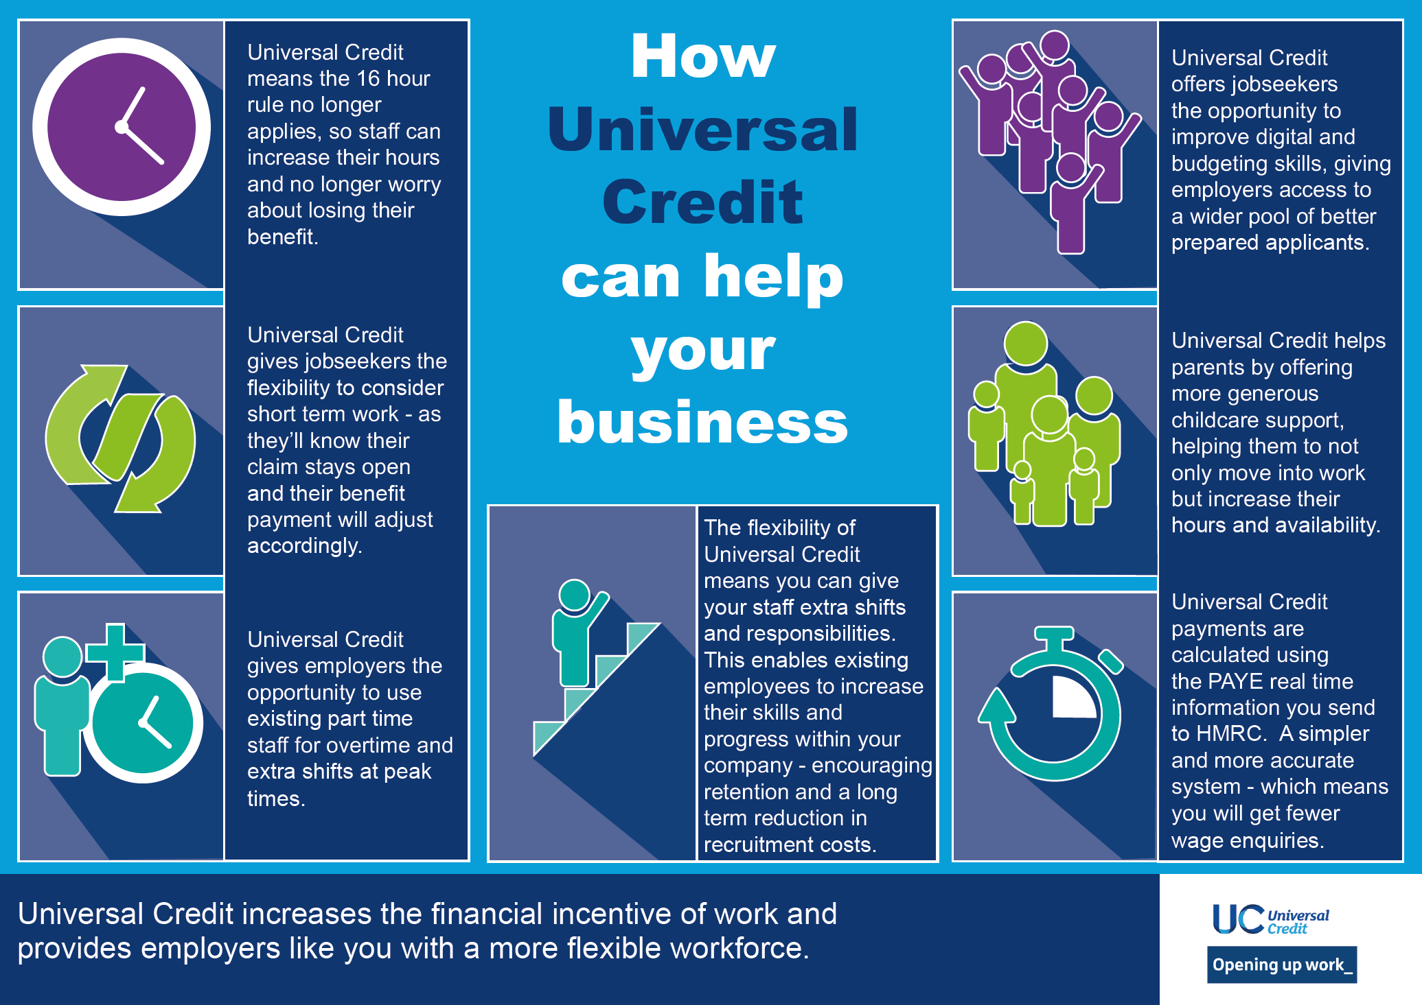
How Universal Credit can help your business

Slide 10

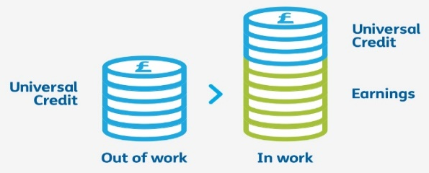
Universal Credit guide for employees
Universal Credit at work
Case Study 1
Sarah lives in Worthing with her 2 children.
She works 20 hours per week while her youngest child attends nursey.
The family rent their home.
Sarah earns £750 per month and receives Universal Credit of £1,425 per month. Total monthly income £2175
Universal Credit is replacing…
Case Study 2
Fiona and John live in Lancing with their 2 children.
John works full time and Fiona works 10 hours per week
The family rent their home
Their combined earnings are £2162 per month and they receive Universal Credit of £761.09 per month.
Total monthly income £2923.09
Universal Credit Earnings Taper
For every £1 you earn over your work allowance(if you are eligible for one) your Universal Credit will only be reduced by 63p.
Case Study 3
Dave is single and lives in Shoreham
He works a variable hour contract. Last month he worked 12 hours. This month he worked 25 hours
Dave rents his home.
Dave’s income last month was earnings of £170.25 and Universal Credit of £730.80. Total monthly income £901.05
This month Dave has earned £354.69 and received Universal Credit of £614.61. Total income £969.30
To see how much better off you could be on UC, go to Entitled To and use their Benefits Calculator!

Slide 11
Sources of Information
Universal Credit - How it Helps Your Employees and Workers - information to help an employer answer any questions their employees may have
Understanding Universal Credit – this new website has a section dedicated to employers
DWP's YouTube channel - with sections on benefits, employment and pensions
Universal Credit For HR and payroll staff – explains the changes and benefits Universal Credit brings for HR managers and payroll staff
HMRC employer bulletins – a bi-monthly bulletin giving employers up to date information on topics and issues which may affect them

Slide 12
Apprenticeships
Apprenticeships have moved on from what they used to be and are an exciting option for both apprentice and employer.
You can now employ apprentices at all different levels, from school leavers to people that want to further their careers or change career direction completely.
An apprentice can be aged 16 or 100 plus!

Slide 13
Apprenticeships
The benefits to your organisation
Hiring an apprentice is a productive and effective way for any organisation to grow talent and develop a motivated, skilled and qualified workforce.
86% of employers said apprenticeships developed skills relevant to their organisation and 78% reported improved productivity.

Slide 14
Apprenticeships
How much will it cost me?
You can get help from the government to pay for apprenticeship training and assessment. The amount you get depends on whether you pay the apprenticeship levy or not. You will pay the apprenticeship levy if you're an employer with a pay bill more than £3 million each year.
If you don't need to pay the apprenticeship levy
As an employer who doesn’t pay the apprenticeship levy, you will need to pay the training provider directly for training your apprentices.
You pay 5% towards the cost of training and assessing your apprentice. The government will pay the rest (95%) up to the Funding Band Maximum. They’ll pay the funds directly to the training provider.

Slide 15
Apprenticeships
Example 1 Financial services administrator | Level 3
Funding band maximum | £12,000
Agreed price with training provider | £12,000
The government will pay | £11,400
Cost to you | £600
Example 2 Rail Infrastructure Operator Funding band maximum | Level 2 £12,000
Agreed price with training provider | £10,000
The government will pay | £9,500
Cost to you | £500

Slide 16
Apprenticeships
Example costs 1:
Is an apprenticeship right for my organisation?
Apprentices will spend at least 20% of their time on off-the-job training with your chosen training provider.
Apprenticeships offer the opportunity to have a flexible, but structured training programme, that meet your organisation's needs.
Apprentices must work towards an approved apprenticeship. Their training must last at least 1 year.
You need to pay the apprentice a salary that doesn’t go below the minimum wage.

Slide 17
Apprenticeships
Choose a training provider
Finding the right apprentice for you
Preparing
Monitoring
Assessment
Certification

Slide 18
Apprenticeships
If you have any questions, contact our employer helpline.
Apprenticeship employer helpline
Telephone 0800 0150 600
www.apprenticeships.gov.uk

Slide 19
Mentoring Circles
A Mentoring Circle is a type of action learning set, where mentees bring issues or challenges to the group and work and learn together, take action and reflect on outcomes with a focus on personal development.
We know many young people do not have access to social capital, role models or inspiring employer mentors. This initiative bridges this gap bringing employers and mentees together.

Slide 20
Mentoring Circles
What is the Return on Investment for your Business to get involved?
Your Company is able to gain valuable insight into the barriers and challenges faced by young people, test out your attraction and recruitment processes and gain insight from jobseekers. An opportunity to make a difference to young people’s lives and tap into a diverse talented pool of jobseekers.

Slide 21
Extra Help
Access to Work
Access to Work supports people with a health condition or disability and their employers. It provides individual practical support and advice to help to overcome barriers to work. It helps people with all types of disabilities including mental health conditions. Grants may help with additional costs beyond “Reasonable Adjustments”.
From 1st April 2019, up to £59,200 is available per year. What could it pay for?
Special equipment or adaptations
Taxis to work for those who can’t use public transport
A support worker or job coach to help in the workplace
A Mental Health Support Service (MHSS) for people who are absent from work or experiencing difficulties with their wellbeing
Disability awareness training for work colleagues
A communicator at a job interview or in the workplace
The cost of moving equipment following a change in location or job
Notes:
£59,200 is per year per person and does not affect any other benefits in payment.
Applications can be made online via gov.uk or:
Access to Work helpline
Telephone: 0800 121 7479
Textphone: 0800 121 7579
NGT text relay (if you cannot hear or speak on the phone): 18001 then 0800 121 7479
Monday to Friday, 8am to 7.30pm
Find out about call charges
British Sign Language (BSL) video relay service
To use this you must:
first check you can use the service
go to the video relay service
Monday to Friday, 8am to 7.30pm
Alternative formats
Call the Access to Work number to ask for alternative formats, such as braille, large print or audio CD.

Slide 22

Disability Confident
The Disability Confident scheme supports employers to make the most of the skills and talents people with a disability, or long term health condition can bring to the workplace.
Through Disability Confident, thousands of employers are challenging attitudes towards disability.
Being Disability Confident could help you discover someone your business just can’t do without!

Slide 23
Any Questions?
Emma Wareham
Coastal West Sussex Partnership Manager
Emma.wareham@dwp.gov.uk
07855319618

